Slide 1
Types of operating system

Slide 2
Batch operating system
The users of a batch operating system do not interact with the computer directly.
Each user prepares his job on an off-line device like punch cards and submits it to the computer operator.
To speed up processing, jobs with similar needs are batched together and run as a group.
The programmers leave their programs with the operator and the operator then sorts the programs with similar requirements into batches.

Slide 3
The problems with Batch Systems
Lack of interaction between the user and the job.
CPU is often idle, because the speed of the mechanical I/O devices is slower than the CPU.
Difficult to provide the desired priority.

Slide 4
Time-sharing operating systems
are very similar to Multiprogramming batch systems.
In fact time sharing systems are an extension of multiprogramming systems.
the prime focus is on minimizing the response time
in multiprogramming the prime focus is to maximize the CPU usage.

Slide 5
Distributed operating System
Distributed systems use multiple central processors to serve multiple real-time applications and multiple users.
Data processing jobs are distributed among the processors accordingly.

Slide 6
Network operating System
A Network Operating System runs on a server
and provides the server the capability to manage data, users, groups, security, applications, and other networking functions.
The primary purpose of the network operating system is to allow shared file and printer access among multiple computers in a network,
typically a local area network (LAN), a private network or to other networks.

Slide 7
Real Time operating System
It is defined as an operating system known to give maximum time for each of the critical operations that it performs,

Slide 8
Difference between lan wan and man

Slide 9
BASIS OF COMPARISON | LAN | MAN | WAN
Expands to | Local Area Network | Metropolitan Area Network | Wide Area Network
Meaning | A network that connects a group of computers in a small geographical area. | It covers relatively large region such as cities, towns. | It spans large locality and connects countries together. Example Internet.
Ownership of Network | Private | Private or Public | Private or Public
Design and maintenance | Easy | Difficult | Difficult
Propagation Delay | Short | Moderate | Long
Speed | High | Moderate | Low
Fault Tolerance | More Tolerant | Less Tolerant | Less Tolerant
Congestion | Less | More | More
Used for | College, School, Hospital. | Small towns, City.

Slide 10
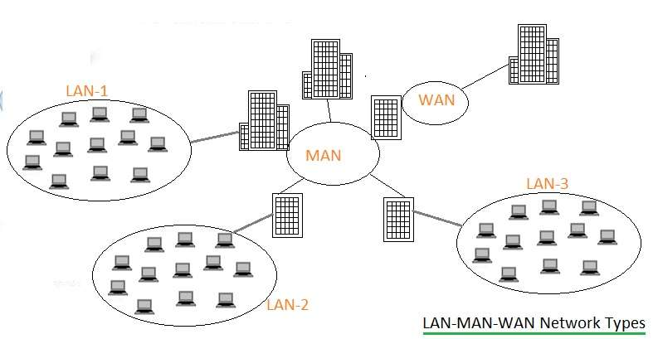

Slide 11
DIFFERENT ERAS OF WEB

Slide 12
The Evolution of Web Design
Early sites were entirely
text-based
with minimal images
no real layout to speak of other than headings and paragraphs
the industry progressed, eventually bringing us table-based designs, then Flash, and finally CSS-based designs.

Slide 13
Web 1.0 The shopping carts & static web
Web 1.0 can be associated with the era of static websites.
used in order to display some information.
No interaction capabilities
During this period, only text mails could be written and sent.
No picture upload
Experts call the Internet before 1999 “Read-Only” web.
There was no active communication or information flow from consumer (of the information) to producer (of the information).
e-commerce website owners use in some shape or form
Goal was to present products to potential customers, much as a catalog or a brochure does

Slide 14
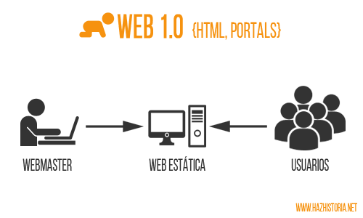

Slide 15
Web 2.0 The writing and participating web
During this stage, websites grew in terms of interaction capabilities.
like YouTube and Blogger.
Berner Lee has also described it as a “read write” web.
like Blogs, social-media and video streaming
easy exchange of music and video clips.
Search engine browsers also entered into an advanced form
capable of managing a large number of users at the same time.

Slide 16
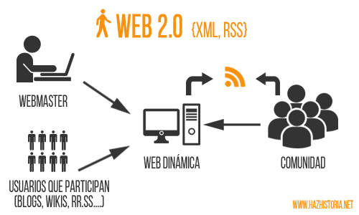

Slide 17
Web 3.0 how, why and when The semantic executing web
Web 3.0 can be described as a “read- write-execute” web.
The two key terms associated with this phase are semantic markup and web services.
A web service is a software system designed to support computer-to-computer interaction over the Internet.
Semantic markup refers to the communication gap between human web users and computerized applications.
Semantic mark up helps in describing an item apart from defining its appearance. It helps in searching the other matched items on the basis of similar attributes.

Slide 18
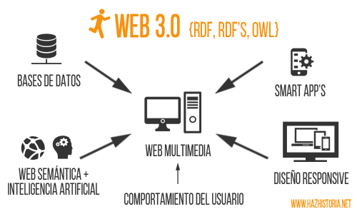

Slide 19
Difference between All eras of web

Slide 20
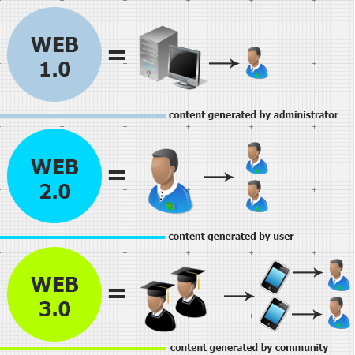

Slide 21
COMPARE STATIC AND DYNAMIC WEBSITES

Slide 22
Static vs Dynamic
A static site is one that is usually written in plain HTML
and what is in the code of the page is what is displayed to the user.
A dynamic site is one that is written using a server-side scripting language such as PHP, ASP, JSP.
In such a site the content is called in by the scripting language from other files or from a database depending on actions taken by the user.

Slide 23
Advantages
Flexibility
every page can be different if desired
Quick to develop
Cheap to develop
Cheap to host
Much more functional website
Much easier to update
New content brings people back to the site and helps in the search engines
Can work as a system to allow staff or users to collaborate

Slide 24
Disadvantages
Requires web development expertise to update site
Site not as useful for the user
Content can get stationary
Slower / more expensive to develop
Hosting costs a little more

Slide 25
Summary
Many sites from the last decade are static, but more and more people are realising the advantages of having a dynamic website.
Dynamic websites can make the most of your site and either use it as a tool or create a professional, interesting experience for your visitors.

